Slide 1
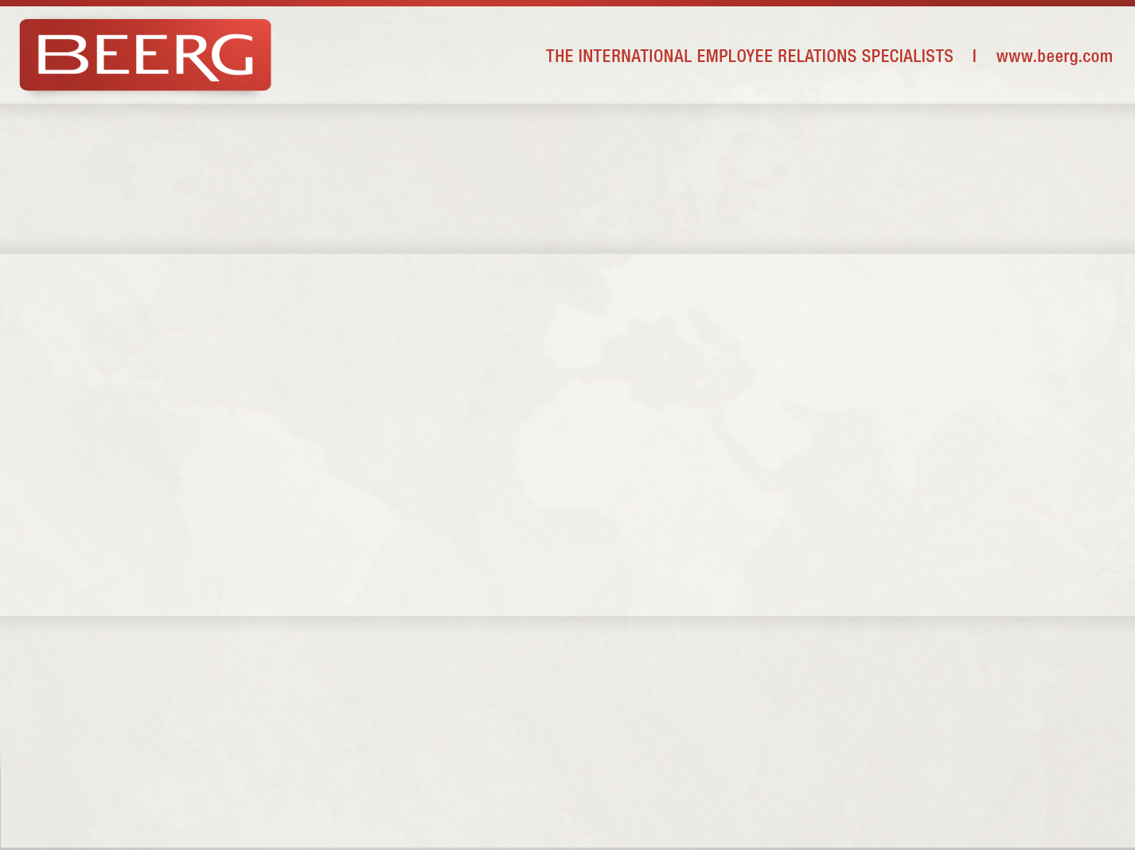
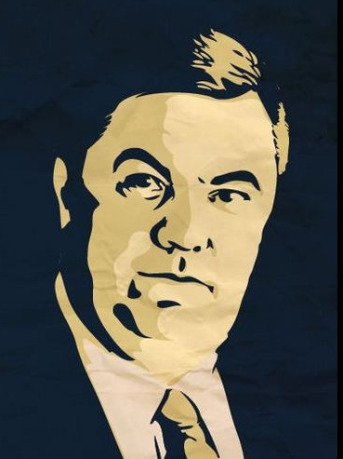

Derek Mooney @dsmooney 3mins
@BEERG The relevance of Social Media to LR/ HR #Twitter
View conversation
Derek Mooney,
BEERG Director Public Affairs

Slide 2

A quick history of….

Slide 3
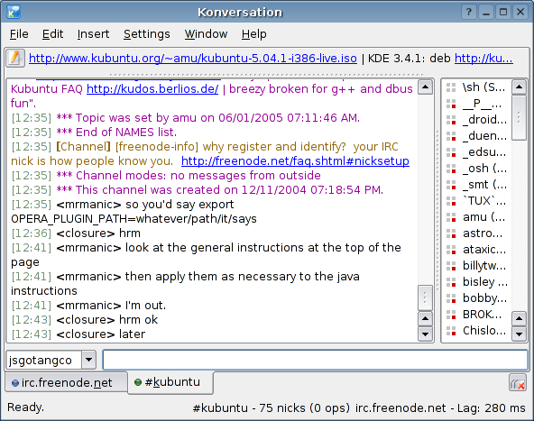










1988 IRC Internet relay chat
1997 WEB LOG & AOL Instant Messenger
1999
2003
2004
2005
2006
2010
2011 550m 56m
2013 1.11bn 500m

Slide 4
WHAT IS SOCIAL MEDIA?
KEYWORDS:
share, communication, interactive, interactions, create, co-create, exchange, user-generated content
It is User-Generated - Content was once only created by a few: Reporters, TV directors, authors etc. Now everyone is a publisher and the people who use the content are also the ones who create it.
It is highly accessible and scalable - Many users and plenty of opportunities. Social media is easy to access with tools available to everyone – very few obstacles.
It is online - location independent and a valuable part of any company’s business strategy.

Slide 5
Reasons to understand Social Media:
#1 online activity surpassing email & pornography
Two-thirds of the global internet visits are to social networks
Social networks growing 3x faster than the internet rate
Social media influential source in consumer purchase decisions
Next 3bn consumers will access internet from a mobile device
Facebook has 1bn active users - averaging one hour/day
One way marketing campaigns are out, Conversations are in
Social Media is FREE

Slide 6





Every 60 sec on the Web
168,000,000 emails sent
600 new videos posted
Over 100,000 Tweets
100 new LinkedIn accounts
700,000 search queries

Slide 7
What makes it Important?
SOCIAL MEDIA: A WAY TO DIFFUSE INFORMATION
No other existing media is capable of diffusing information faster than social media as it is a shift in how people discover, read, and share news, media, and content. Television and newspaper are no longer main means of filtering and sharing news. People are more likely to get their news by reading Trending Topics on Twitter,
SOCIAL MEDIA IS A FUSION OF SOCIOLOGY AND TECHNOLOGY
Social media is user-controlled, which means that sociologic components play a large role in any company’s social media business strategy. The limits of social media are only set by the limits of the technology of social media tools
SOCIAL MEDIA IS A DIALOGUE
At one time, companies had a monologue with its customers. Companies put out television commercials or print ads about its products and then waited to see whether the sales rolled in to determine success rates. Now, social media allows companies to have a dialogue with its customers and gain valuable feedback and input as it creates the message.
SOCIAL MEDIA IS THE DEMOCRATIZATION OF INFORMATION
Information and messaging for a company was once controlled by it’s marketing and sales departments. Now, with the democratization of information, no one owns the message about a product or company. If you do not become part of the conversation you risk letting users become the voice of the company.

Slide 8
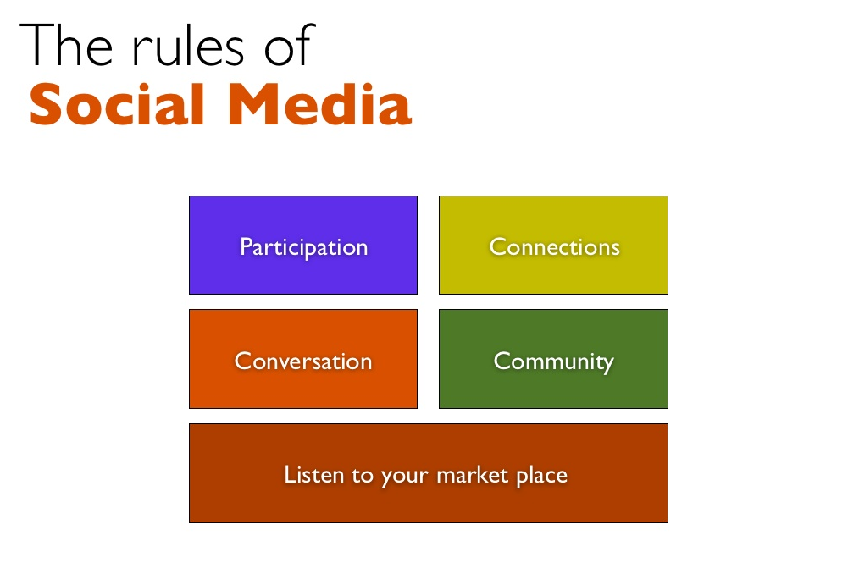

Slide 9
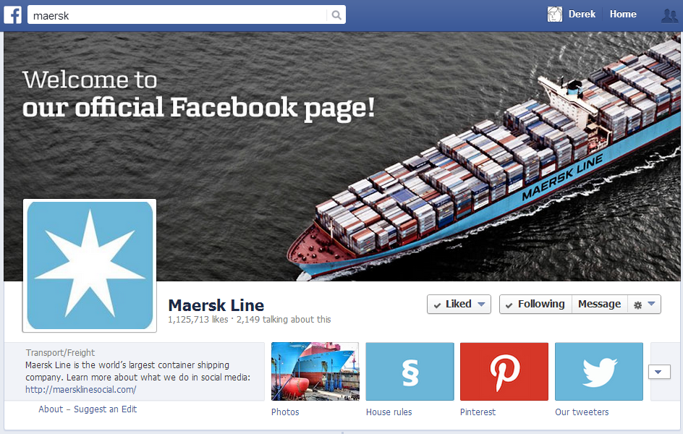

Slide 10
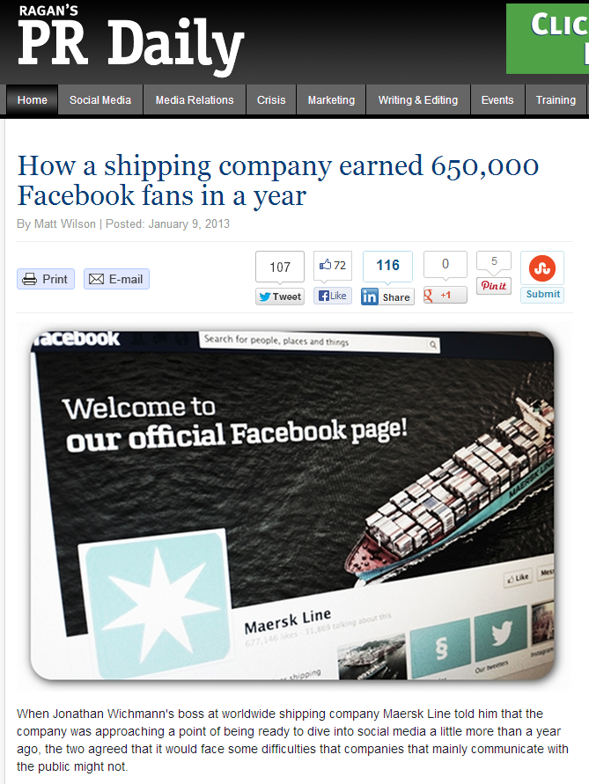
Maersk Story
Maersk spent $60,000 on management tools, advertising, and some infrastructure work.
Having a single, consistent voice has made Maersk's content compelling
The company is active on 10 social networks
On Instragram they have #maersk spotting: encouraging users to post photos of Maersk containers when on the street or on a ship.

Slide 11
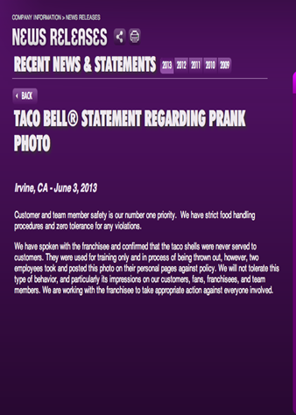
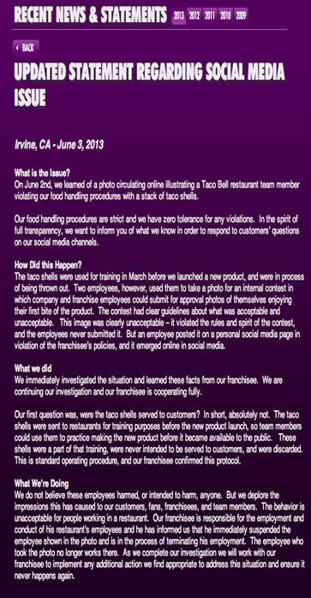
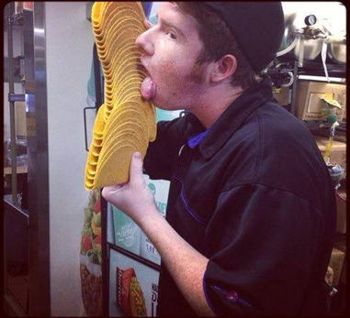
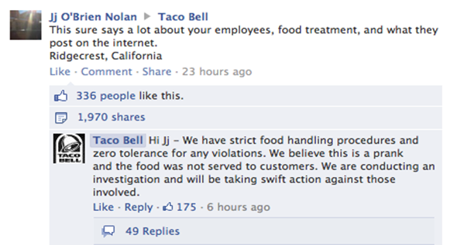


TACO BELL

Slide 12
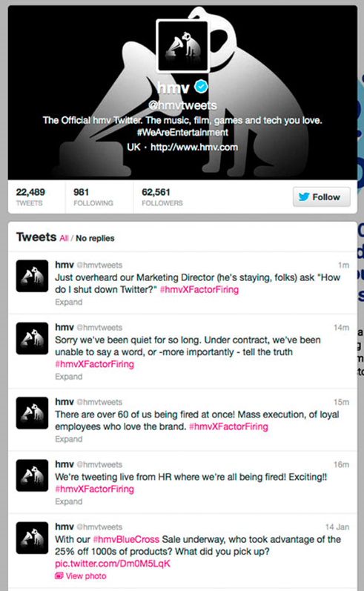
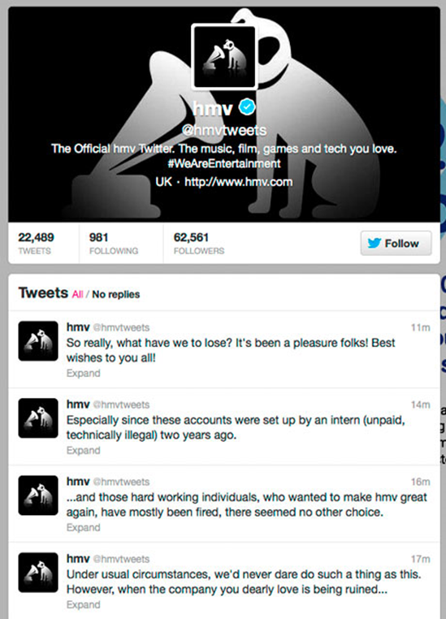


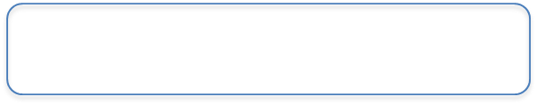
HMV

Slide 13
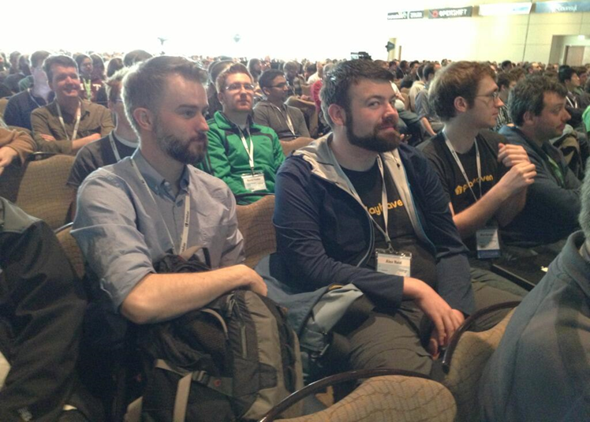
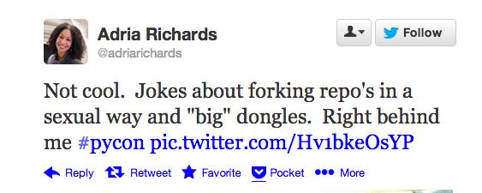
PyCon
playHaven
SendGrid

Slide 14
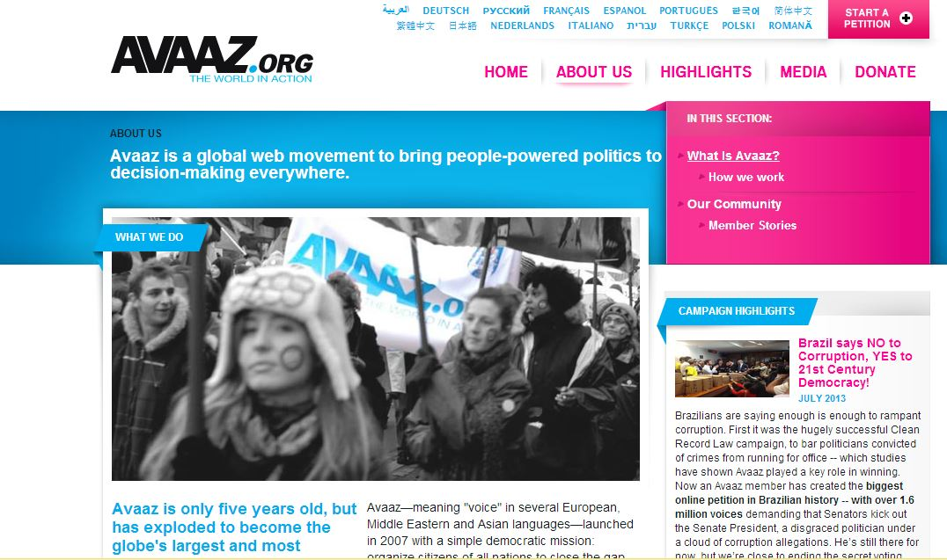
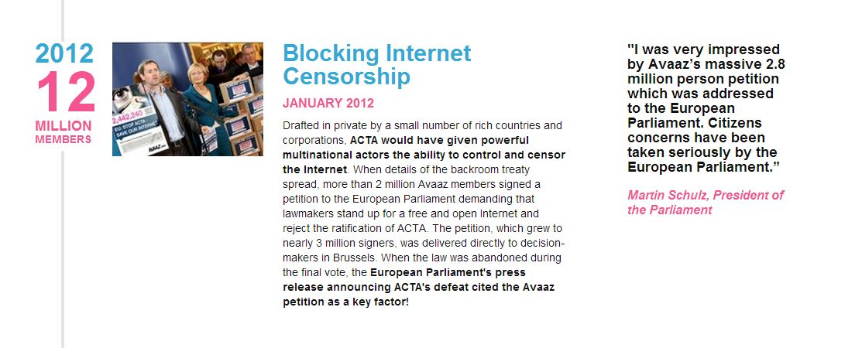
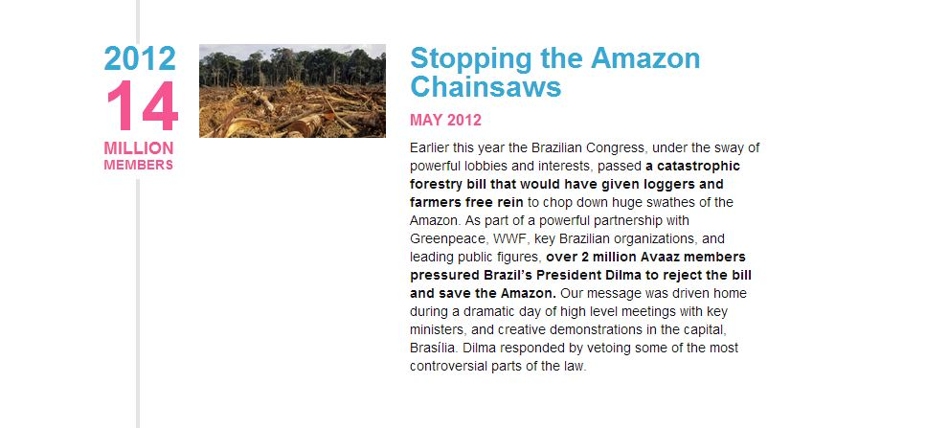
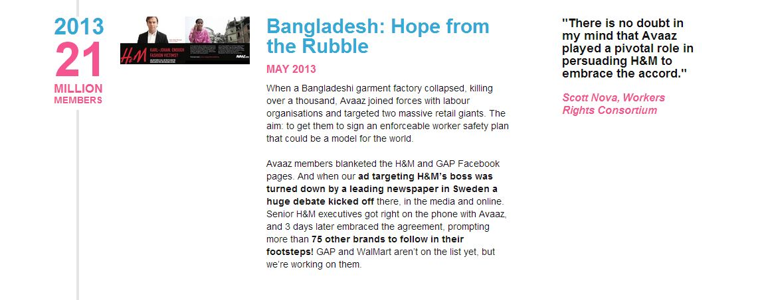
Avaaz.org
Avaaz (Voice) a global online civic organization (26m+ members) launched in 2007 to promote activism on such issues as: climate change, human rights, animal rights, corruption, poverty, and conflict.
It works to "close the gap between the world we have and the world most people everywhere want.”
Click-tivism in place of activism?

Slide 15
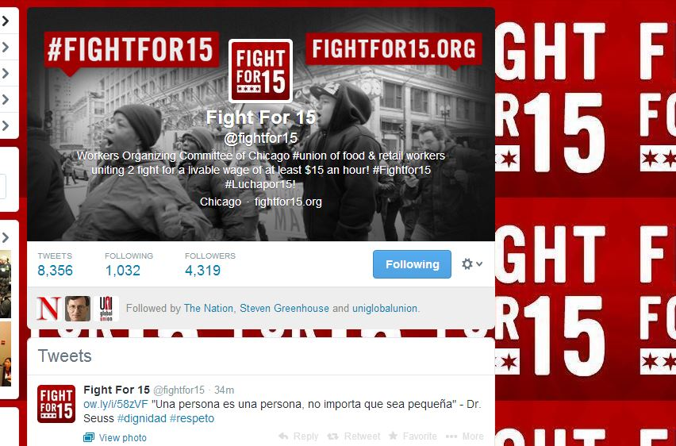
Union-backed “Worker Centres”

Slide 16
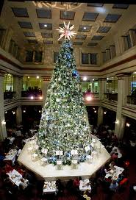
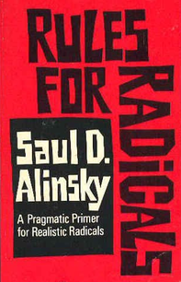
The “Fight for 15” & Macys
The Grassroots Push
Spring 2011 - Summer 2012
The “Union” Created
Fall - Winter 2012-13
The Movement Takes Off
Spring - Fall 2013
The Push Got Bigger:
“Pick the target, freeze it, personalize it, and polarize it”
Notes:
In early fall of 2012, the group became even more aggressive. Organizers were at our doors and in our stores trying to get associates to meet with them – even taking them for coffee to hear their pitch. Associates reported aggressive at home visits and phone callers that would use their relatives, even their doorman, to track them down at work and ask them to join their group.
The organizers were blanketing downtown Chicago and hitting just about every food and retail business. We even had an organizer on our sales floor, dressed like one of our associates and straightening out merchandise while trying to solicit an associate.
In early November 2012, the group staged a demonstration during our annual tree lighting in the State Street store. They began shouting and dropping leaflets while the children’s choir was singing. They continued to shout and move through the store, interrupting the tree lighting by a child from the “Make a Wish” Foundation. Neither our customers or our associates were impressed with the group’s actions. However, some associates did say that while they did not agree with the behavior, they did find truth to their message of a living wage.
It occurred to us that we were dealing with a radicalized group, using overt tactics to “organize,” and we became familiar with Rules for Radicals by the guy thought to be the “father of community organizing”, the late Saul Alinsky. One of the “rules” clearly tells organizers to “Pick the target, freeze it, personalize it, and polarize it. The group had already picked the target – Downtown Chicago low wage workers, they were trying to freeze it with protests and stunts like the tree lighting, so now they had to personalize and polarize it.

Slide 17
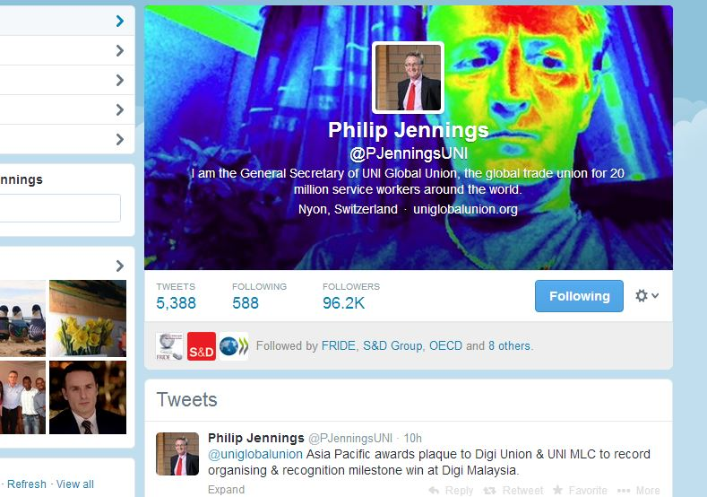
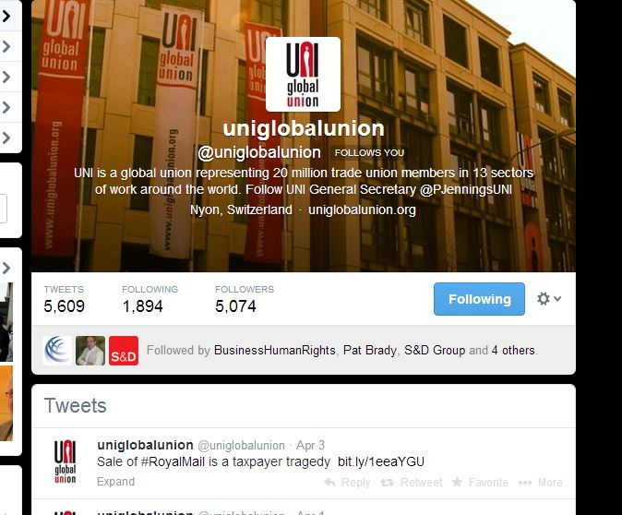
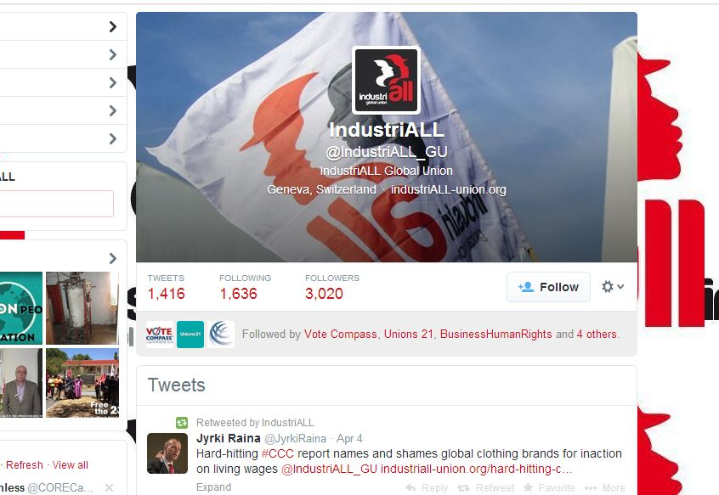
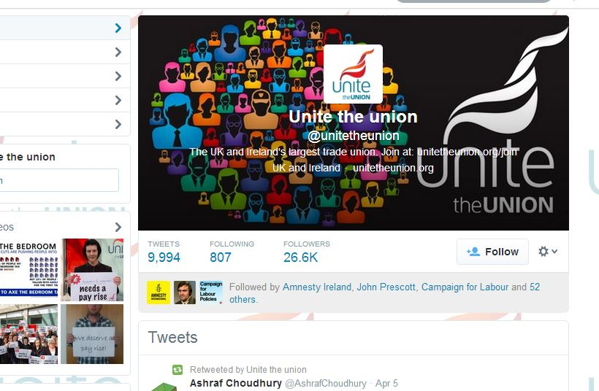
Compare and Contrast

Slide 18
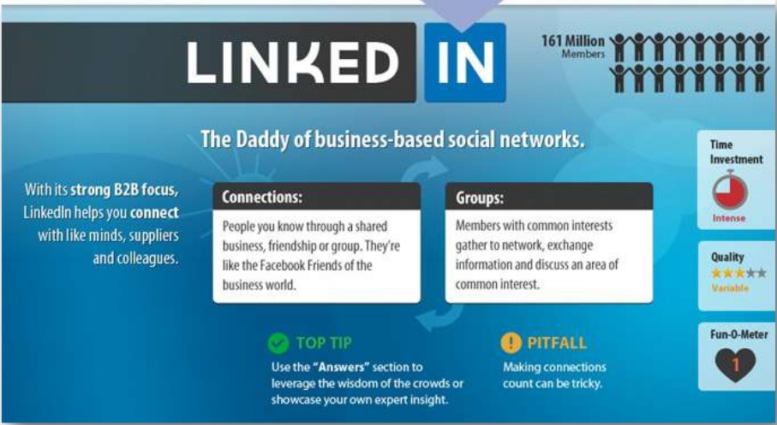
200+ Million
Users

Slide 19
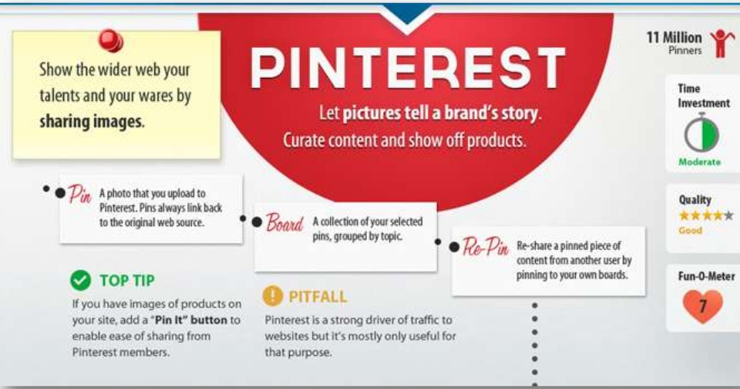
49 Million
Pinners

Slide 20
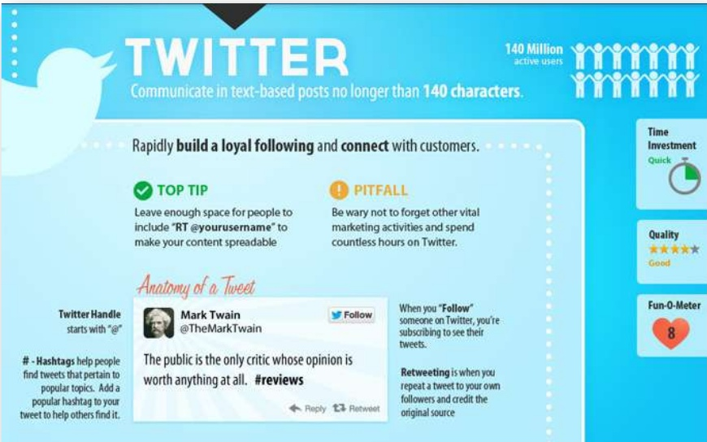
500 million
Users

Slide 21
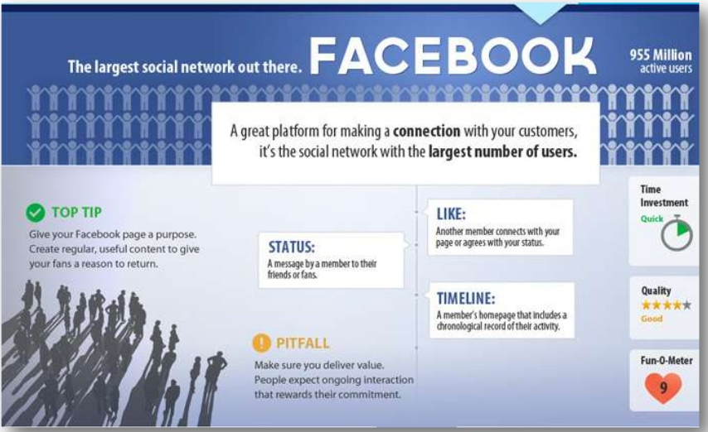
1.11Billion
Users

Slide 22


Weibo
Over 300 million registered users
Almost 100% of posts generated by just 5% of users

Slide 23
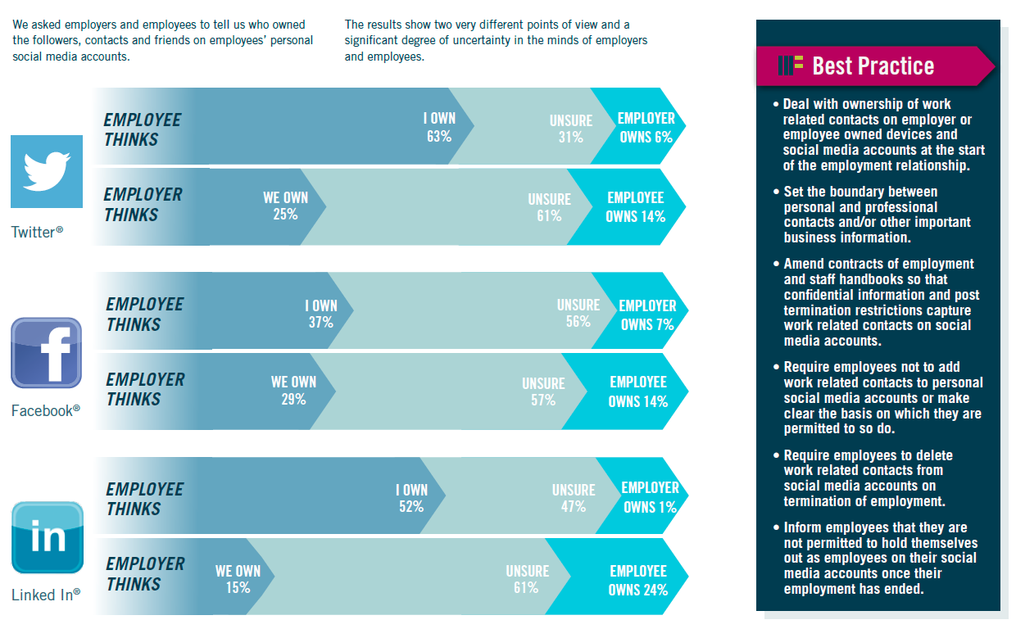

Slide 24
Legal trends
Privacy - Are comments posted “private”?
Proportionality - Is dismissal justified?
Freedom of speech - Does dismissal or discipline breach right to freedom of speech?

Slide 25
Social Media Policy
ACAS guidelines + cases stress importance of having a policy
What should a policy contain?
Use of social media during working hours?
Scope – inside/outside work, employer systems or home PC?
Clear statement of what is unacceptable
Any carve outs for specific classes of employee?
Direct link to disciplinary policy
Ius Laboris Social Media Guide: http://www.iuslaboris.com/publications

